Slide 1
Michelle Honours Project Photobook

Slide 2
Annelida

Slide 3
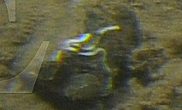
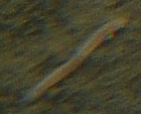
Serpulidae (F.) sp. 1
Calcareous tubes with white plume at end occasionally visible. Observed on rock or horizontally across soft sediment.
Polychaete (SP) sp. 1
Epibenthic polychaete on sediment - pinkish red. Looks too 3D to be a nemertean
Notes:
* Sabellidae needs to be reviewed. Could be two different species, but it’s hard to distinguish between them. Show this to Lenka.

Slide 4
Arthropoda

Slide 5
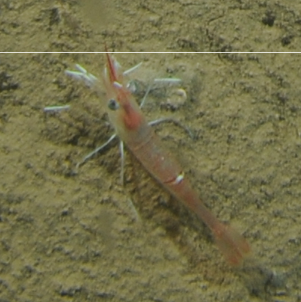
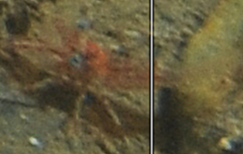
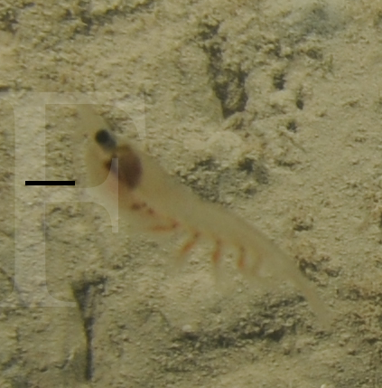
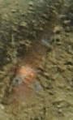
Pandalidae (F.) spp.
White legs, translucent body with redish internal organs.
Meganyctiphanes norvegica

Slide 6
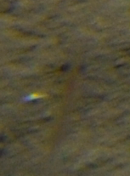
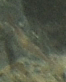
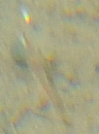
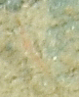
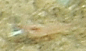
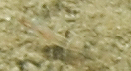
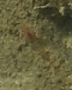
Malacostraca (C.) sp. 2
Small eyes (?) with short, semi-translucent body. Body red-pink in colour. Could be juvenile Pandalid shrimp. Very small.
Malacostraca (C.) sp. 1
Large eyes and a semi-translucent body. Either M. norvegica or Pandalidae
Malacostraca (C.) sp. 4
Small eyes with a semi-translucent body. Top body (carapace?) red in colour and a semi-translucent tail. Could be the same as Malacostraca sp. 2, but too small to tell.

Slide 7
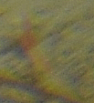
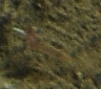
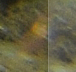
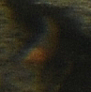
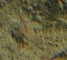
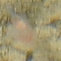
Malacostraca (C.) spp.
Likely several species of Malacostraca, but too blurry to identify.

Slide 8
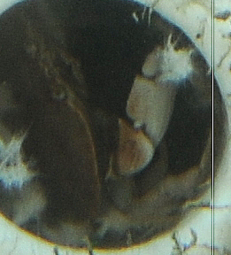
Crustacea (SP.) sp. 1
Inside Vazella pourtalesi. Red carapace and white legs. Most legs and claws not visible.

Slide 9
Bryozoa

Slide 10
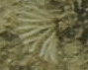
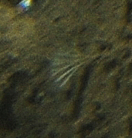
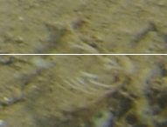
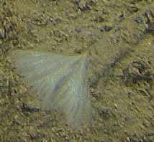
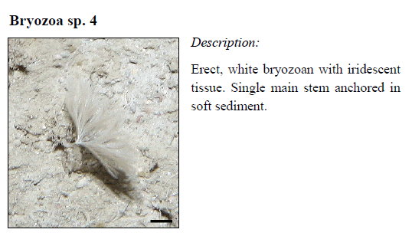
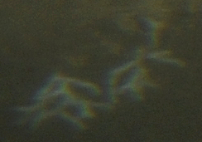
Bryozoa (P.) sp. 2
Fan-shaped white broyozoan with relatively thick dichotomous branches.
Bryozoa (P.) sp. 1
Erect, fan-shaped dichotomous branching bryozoan. Tan to white in colour.
Bryozoa (P.) sp. 3
Flattened, white bryozoan with iridescent tissue. Single main stem anchored in soft sediment.

Slide 11
Chordata

Slide 12
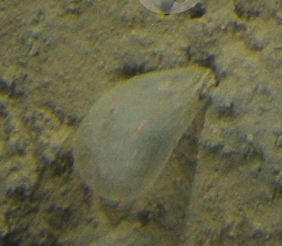
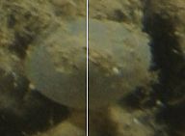
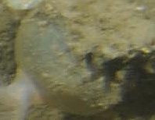
Class Ascidiacea
Ascidiacea (C.) sp. 2
Spherical ascidian some with anemone attached. On rock or dead V. pourtalesi.
Ascidiacea (C.) sp. 1
Oblong-shaped ascidian. On soft sediment.

Slide 13
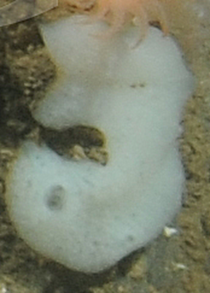
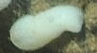
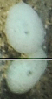
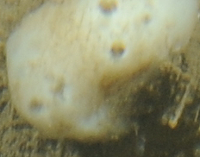
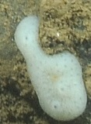
Family Didemnidae
Didemnidae (F.) sp. 1
Colonial tunicate. Can be globular in form, or more flat and horizontally spreading. Siphons visible, sometimes chimney-like. Typically white, or a variety of white. Very similar to the Didemnidae in the tech report.

Slide 14
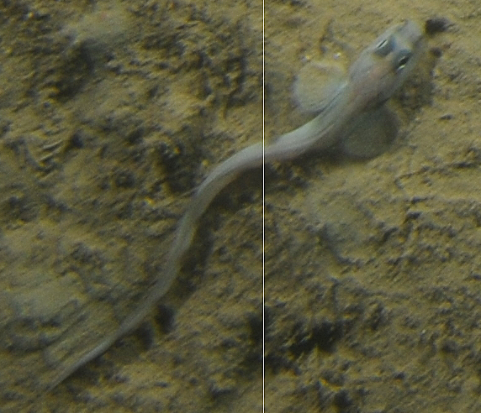
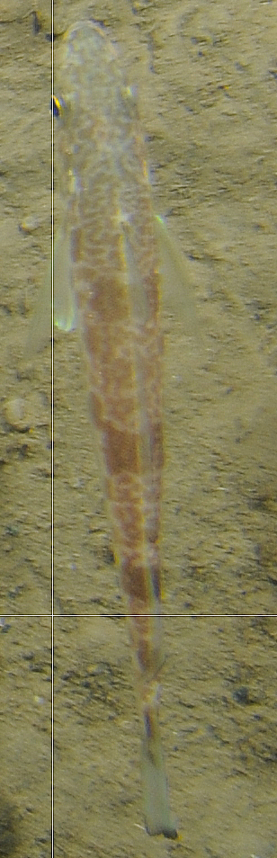
Osteichthyes (Sc.) sp. 1
Long slender fish with large pectoral fins. Continuous dorsal fin running length of body. Eyes on top of head. Could be Lycodes.
Actinopterygii (C.) sp. 1
Alternating bands of solid brown and spotted brown. Truncate caudal fin, black at tip. Two dorsal fins, first fin small while second fin continues down body. two dorsal fins.

Slide 15
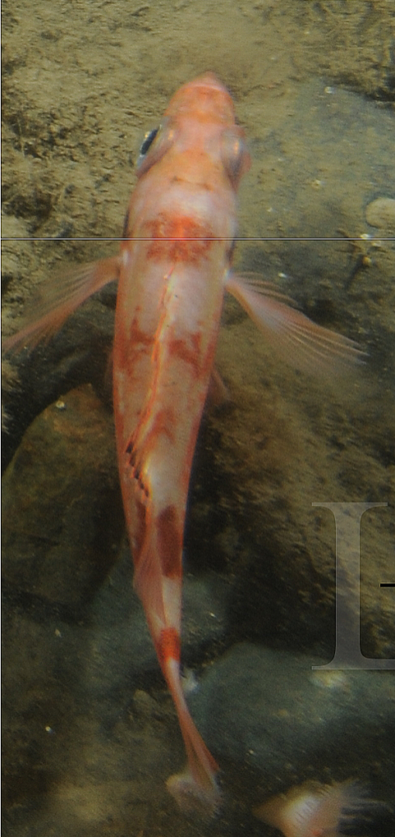
Sebastes sp. 1
Redfish with alternating bands of dark and light pink. Large dorsal fin with orange and black at the tip.

Slide 16
Cnidaria

Slide 17
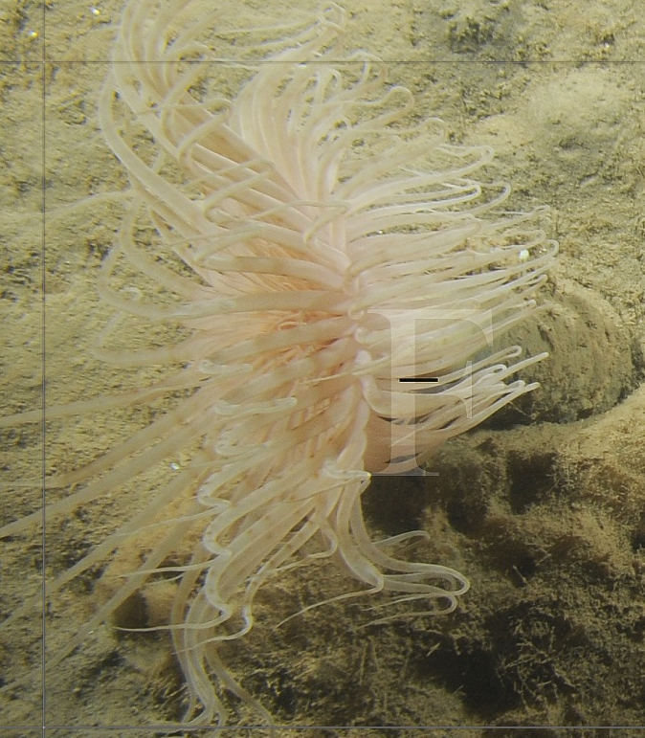
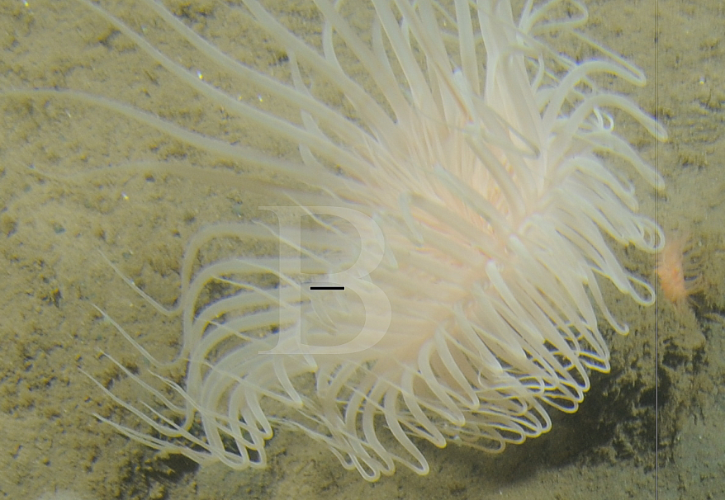
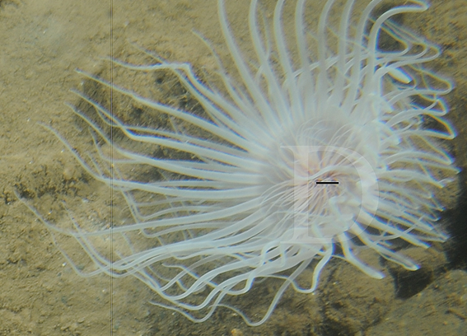
Pachycerianthus borealis (Verrill, 1873; WoRMS)
Large white to pink tube-dwelling anemone. Long, typically banded marginal tentacles often in a biplanar array. Oral tentacles small and often hard to see. Oral tentacles are often slightly darker in colour as well.
Notes:
Anemone-like anthozoans; elongate, tapering basally, aboral end rounded living in secreted tubes buried in sand or mud; tentacles in two distinct whorls.
-Invertebrate zoology (Barnes, RB); Guide to ID of marine and esturarine invertebrates Cape Hatteras to the Bay of Fundy (Gosner, KL)

Slide 18
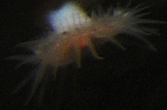
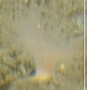
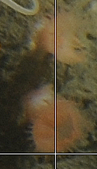
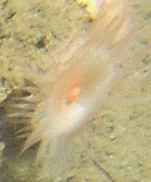
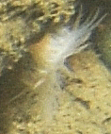
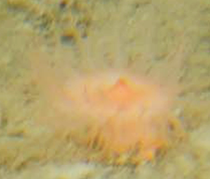
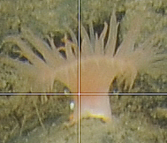
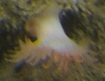
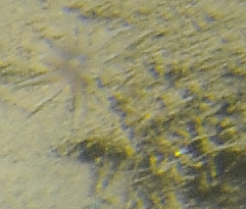
Order Actiniaria
Actiniaria (O.) sp. 4
Pale pink-pink anemone with two rows of relatively short tentacles, relatively large cup and short column.
Members in this group appear to be different species
Actiniaria (O.) sp. 6
Sediment covered tentacles with purple oral disk.
Notes:
Solitary anthozoans with neither internal skeleton of calcareous spicules nor solid external skeleton, aboral end either adherent pedal disc or, in burrowing forms, tapered and rounded terminally; burrowing species with a single whorl of tentacles. Oral disc armed with unbranched tentacles, in single or multiple rings. Most are more or less contractile both in column and oral disc.
-Guide to ID of marine and esturarine invertebrates Cape Hatteras to the Bay of Fundy. Gosner KL.

Slide 19
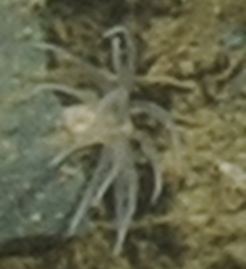







Actiniaria (O.) sp. 8
Large anemone with pink oral disk and lighter tentacles. Thick tentacles in multiple rows. Column not visible.
Actiniaria (O.) sp. 9 Small column. Long semi-translucent tentacles. Usually on rock and a few on soft sediment
Actiniaria (O.) sp. 19
Small white anemone with a relatively small cup. Many very thin tentacles and a peach coloured mouth. **
Actiniaria (O.) sp. 16
Orange-pink anemone with a few rows of relatively short tentacles, relatively large cup and short column.
Actiniaria (O.) sp. 20
Small anemone with a white column and cup. Tentacles semi-translucent to light pink and about equal size to cup. **

Slide 20





Actiniaria (O.) sp. 21
Orange-pink anemone-like organism. Very short column and very wide cup. Short tentacles, likely in one row and slightly darker protruding mouth.
Actiniaria (O.) sp. 22
Small pale pink-peach anemone. Relatively large cup and short stubby tentacles.
Actiniaria (O.) sp. 24
White anemone with a small cup and relatively short column. Tentacles greater than or equal to cup in length. Peach-pink coloured protruding mouth. **

Slide 21

























Actiniaria (O.) spp.
Taxon includes several species of Actiniaria that were difficult to distinguish. Usually small, colour ranges from orange-pink to white or semi-translucent . Individuals are sometimes found on Vazella spicules. Some have retracted, or mostly retracted, so distinguishing characteristics are not visible.
Notes:
Could some be Hormathiidae’s?? The ones with slightly retracted tentacles??

Slide 22



Bolocera spp.
Large, smooth anemone with a protruding mouth. Long tentacles in several rows. Redish pink to pale orange in colour. Could all be one species but uncertain.

Slide 23





Order Zoantharia (WoRMS)
Zoantharia (O.) sp. 1
Colonial zoanthid with long polyps. Yellow column with thin, white to light pink tentacles.
Notes:
Colonial, anemone-like anthozoans united basally, or solitary. Body may be columnar, but many are short and button-like. Short fringe of tentacles surrounds broad oral disc
-Invertebrate Zoology, Barnes, RD

Slide 24











Zoantharia (O.) sp. 4
Colonial zoanthid with long polyps. Redish-brown column.
Zoantharia (O.) sp. 2
Burrowing zoanthid, sediment covered column with short white tentacles.
Zoantharia (O.) sp. 5
Colonial zoanthid with long sediment covered polyps. Relatively small cup and very thin tentacles in two whorls. Could be Hormathiidae? Looks similar to Hormathiidae s. 7 from the tech report.
Zoantharia (O.) sp. 9
Colonial zoanthid with long sediment covered polyps. White, medium sized cup and one row of very thin, semi-translucent tentacles.
Zoantharia (O.) sp. 10
Colonial zoanthid with long polyps. Column is light orange in colour and smooth. Very thin tentacles of a lighter orange.

Slide 25



Zoantharia (O.) sp. 11
Colonial zoanthid with relatively long polyps. Column is a light peach colour and smooth. Zoanthids are much thicker than others seen. Long thin tentacles, light pink in colour.
Zoantharia (O.) sp. 12
Colonial zoanthid with long polyps. Column is yellow in colour, some are partially covered in sediment and some are smooth. Could be that some are more mature.
These may be the same species

Slide 26








Zoantharia (O.) spp.
Multiple species suspected based on different colour, length of tentacles and column. Almost always coloial, but can occur as individual polyps. Polyps light ranging between white to yellow to salmon.
Notes:
Javier suggested to group all Zoanthids as Zoantharia spp.

